Slide 1
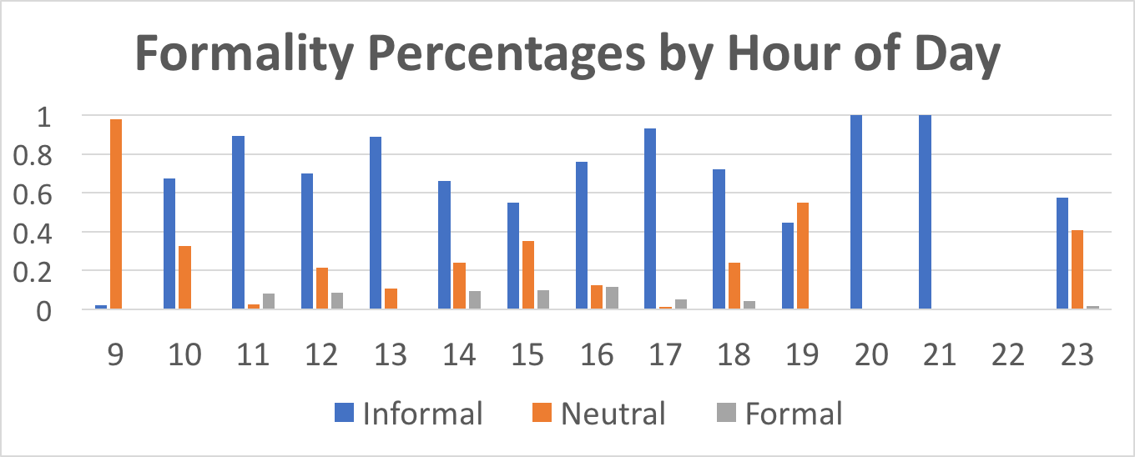
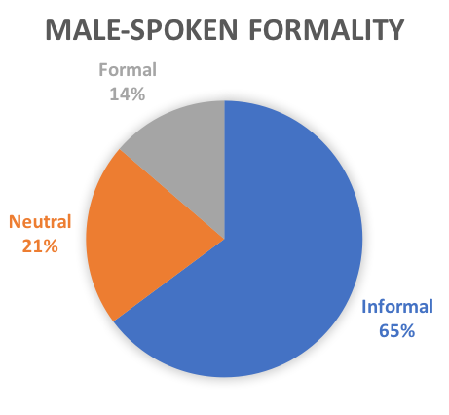
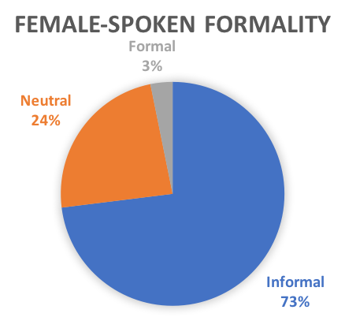
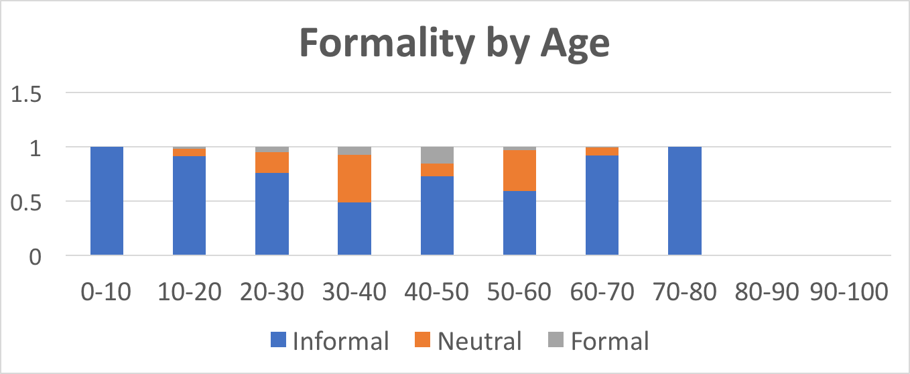
Business as Usual: An Analysis of Formality in Palo Alto Coffee Talk
Team 15: Andrew McCabe, Anna Zappone, Ariana Johnson, Aaron Brackett, Max Savage, Griffin Koontz
Research Question
Results
How does a speaker’s use of formal language vary with their age, gender, and the time of day?
Informal language is used over 11 times more than formal language. At almost all times of day, It is used most.
People tend to be more formal during business hours, 9am-5pm
Professional aged people are more likely to speak formally
Men’s speech contains over four times more formal language than women’s
Related Work
“The degree of formality of a speech-style will depend on the requirements of the situation...depending on whether the speaker prefers accuracy over immediacy, detachment over involvement, or fears possible misinterpretation more than additional cognitive load” (pg. 33, Heylighen 1999).
“Formality increases when the distance in space, time or background between the interlocutors increases, and when the speaker is male, introverted or academically educated” (pg. 1, Heylighen 1999).
Error Analysis
Lack of a standard formatting template lead to lots of incorrectly formatted data being thrown out.
The level of formality being used in a conversation is hard to judge in the English language
Time slots with a low number of conversations disproportionately impact data (for example, only one conversation happened at 9am)
Methods
Cleaning the Data
The levels of formality were reduced to three levels: informal, neutral, and formal
All data that did not code formality was excluded
Formality was standardized to ignore ambiguous inputs (e.g. khakis + scrubs = ?, lululemon)
Age ranges were converted to the average of the age range
Data points where the labelled time range exceeded a single hour were ignored
Analyzing the Data
Recorded the total number of utterances in each time slot
Assigned formality level to each utterance
Determined the percentages of utterances of formality level overall
Also analyzed previous measurements with respect to age & gender
Discussion
Finding supports Heylighen’s assertion that men use more formal speech
Rises in formal talk fit flow of the business day
Works Cited
Heylighen, F. (1991) Design of a Hypermedia Interface Translating between Associative and Formal Representations, International Journal of Man-Machine Studies 35, 491-515.
Heylighen, F. (1992a) From Complementarity to Bootstrapping of Distinctions: a Reply to Löfgren's Comments on my Proposed 'Structural Language', International Journal of General Systems Vol 20, Number 4.
Notes:
Old intro1 :
Recent research has shown that crowd workers can accomplish distributed, analogical idea generation through the decomposition of tasks that crowd sourcing is typically known for.
With SNAC we aim to demonstrate how we can use facilitated conversation to take advantage of each crowd worker’s unique perspectives towards discovering new solutions to open ended problems.
Old Intro 2:
Recent research has worked towards showing that modularized crowd work can be used to solve open ended problems:
Crowd workers contribute small pieces individually towards a big picture view of a topic such as a Wiki article (Hahn et al., 2016)
Problem abstraction, searches for analogical inspiration, and idea generation are divided among workers (Yu et al., 2016)
With SNAC we aim to demonstrate how facilitated conversation can be used to take advantage of each crowd worker’s unique perspectives in an effort to discover new solutions to open ended problems.
Notes:
Recent research has begun to show that distributed crowd work can be used to

